Slide 1
Laptop Price Prediction for SmartTech Co.
BY Keerthana D

Slide 2
Project Overview:
SmartTech Co. has partnered with our data science team to develop a robust machine learning model that predicts laptop prices accurately. As the market for laptops continues to expand with a myriad of brands and specifications, having a precise pricing model becomes crucial for both consumers and manufacturers.
Client's Objectives:
Accurate Pricing: Develop a model that can accurately predict laptop prices based on various features, helping our clients stay competitive in the market.
Market Positioning: Understand how different features contribute to pricing, enabling SmartTech Co. to strategically position its laptops in the market.
Brand Influence: Assess the impact of brand reputation on pricing, providing insights into brand perception and market demand.

Slide 3
Project Objective: To develop a machine learning model that accurately predicts the price of a laptop based on its technical specifications and brand attributes. The goal is to assist consumers, retailers, and manufacturers in understanding key price-driving factors and enabling smart pricing or purchasing decisions using data-driven insights.

Slide 4
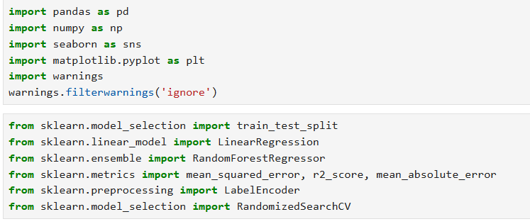

Import Library
Loading Dataset

Slide 5
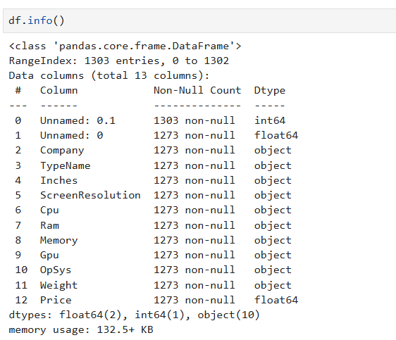
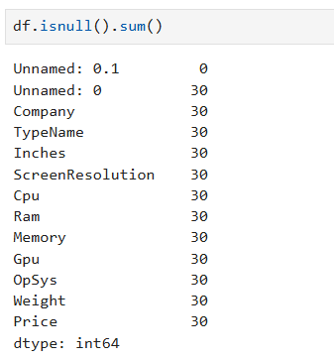



Data Exploration and Understanding

Slide 6
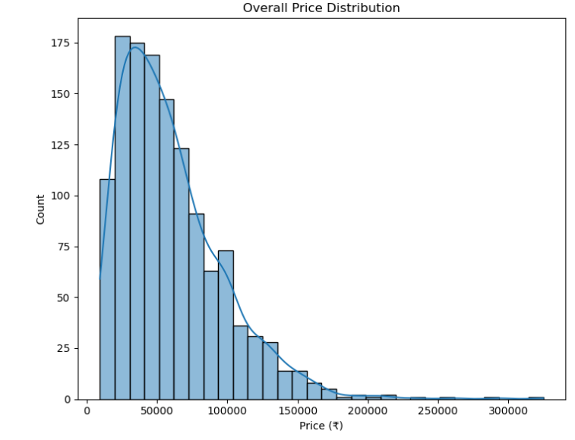
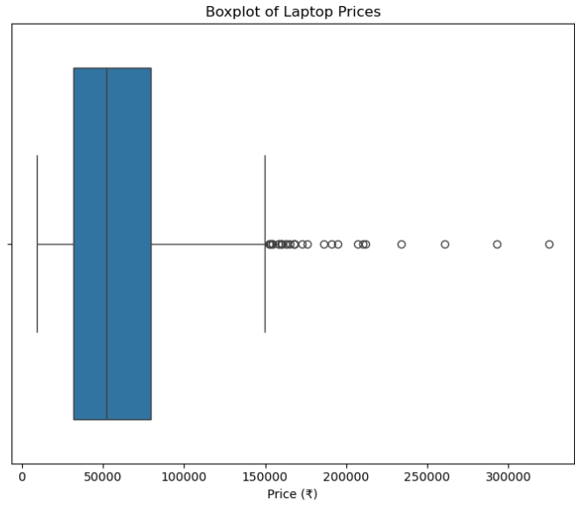
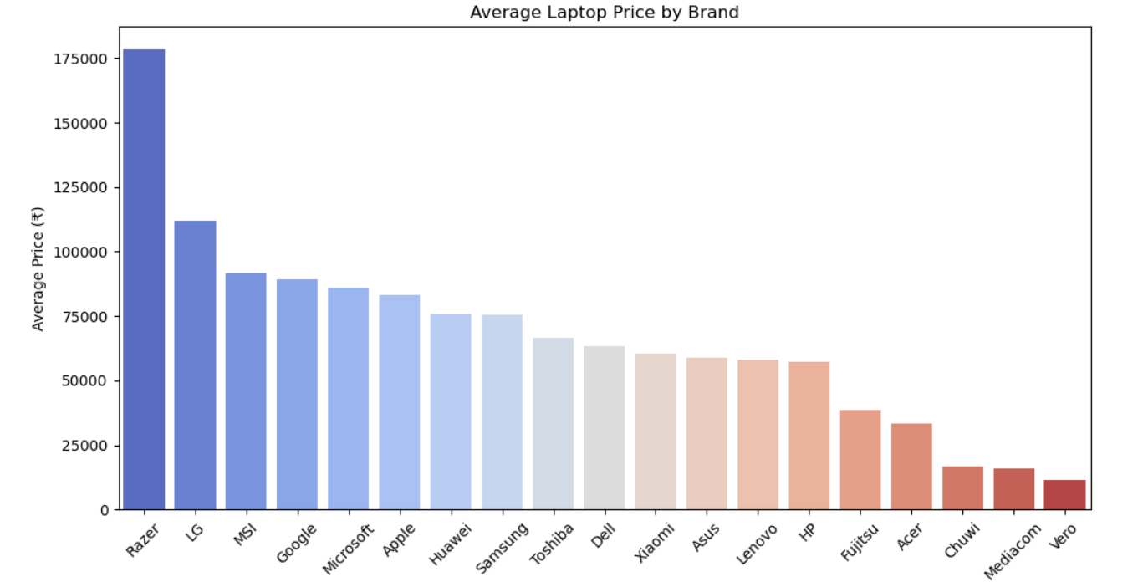
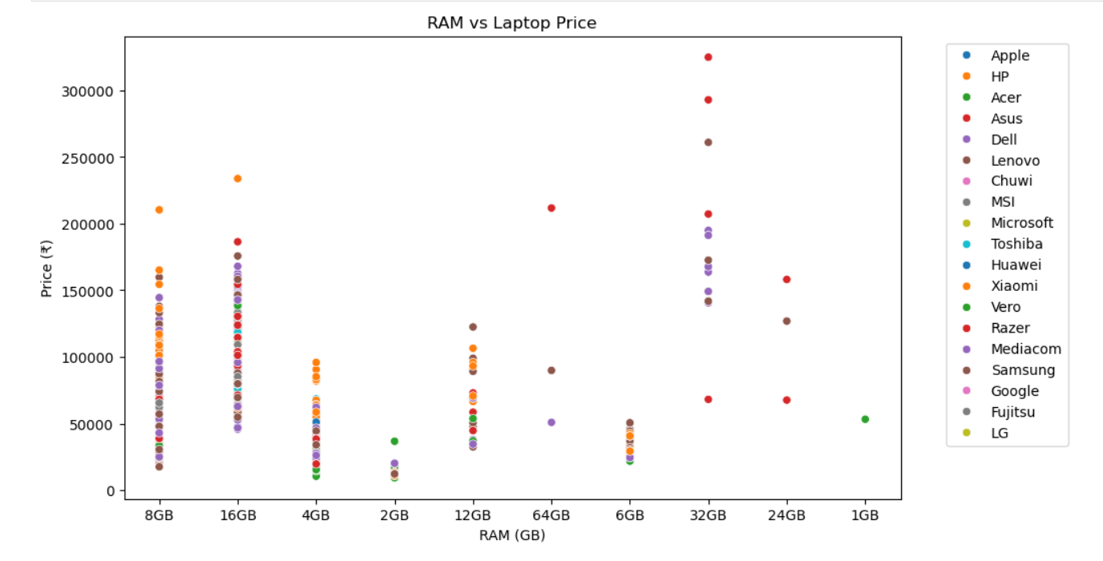

Slide 7
Challenges:
Diverse Specifications: The dataset includes a wide range of configurations (e.g., hybrid memory, varying screen resolutions), which adds complexity to model generalization. Data Quality: Initial raw data includes missing values and inconsistencies (e.g., non-numeric strings like '?'), requiring thorough preprocessing. Interpretability: Model predictions must be explainable to help stakeholders understand which features drive pricing decisions.

Slide 8

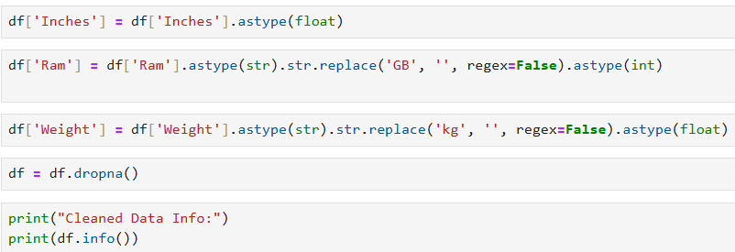
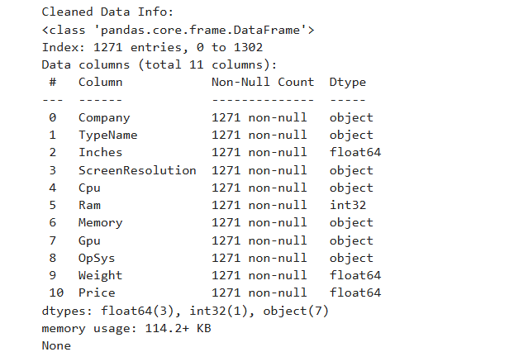
Data Preprocessing

Slide 9
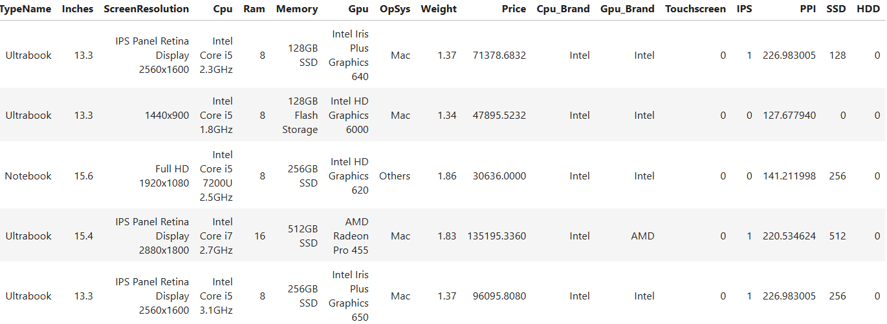
Feature Engineering

Slide 10
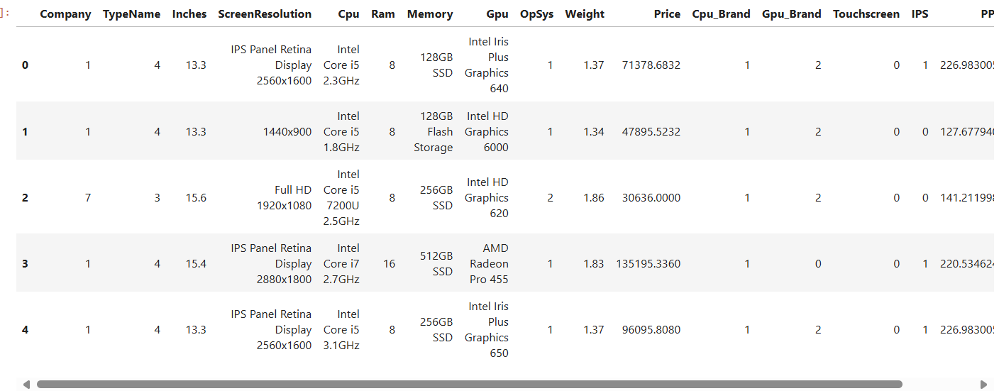
Label Encounters

Slide 11
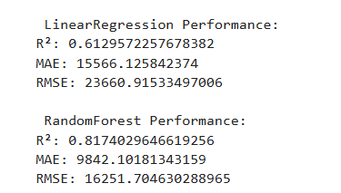
Model Development

Slide 12
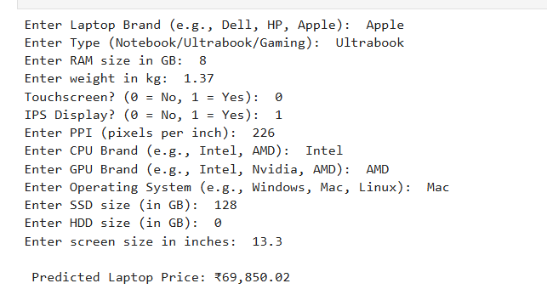
Real-time Predictions

Slide 13
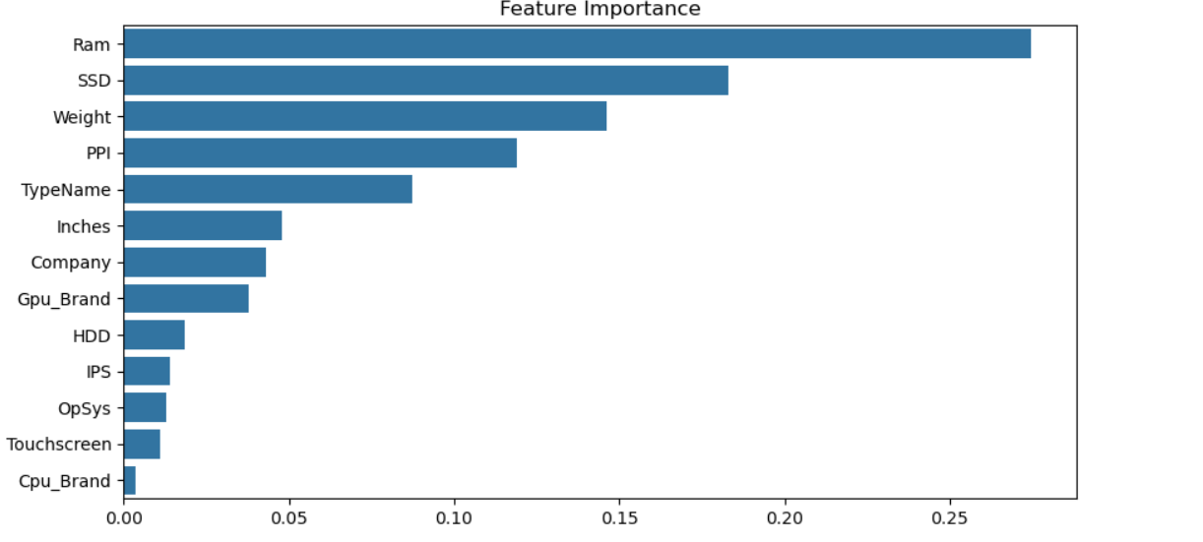
Interpretability and Insights RAM Size – More RAM generally correlates with higher price. Storage Type (SSD vs HDD) – SSD-based systems are priced higher. Screen Size & Resolution – Larger and higher-resolution displays increase the price.

Slide 14
The model performs reasonably well for lesser-known brands if they are well-represented in the training data.
Yes, brand has a strong influence on laptop pricing even when controlling for specs.
Budget laptops (with basic specs) are predicted more accurately, as they follow standard pricing patterns.
Some key limitations include: Rapid Market Changes, Unstructured Features, Data Imbalance, Missing Specifications
The model may underperform on newly released laptops due to: Unseen combinations of specifications. Technological advancements not represented in training data. Lack of pricing history or reference points.

Slide 15
Recommendations for SmartTech Co. Leverage Predictive Pricing for Product Strategy→ Use the trained machine learning model to predict optimal prices based on specifications, helping SmartTech price laptops competitively while maintaining margins. Enhance Brand Value to Justify Premium Pricing→ Since brand significantly impacts price, SmartTech should invest in branding, quality assurance, and marketing to increase perceived value and allow premium pricing even for similar specs.

Slide 16
Conclusion This project successfully built a machine learning model to predict laptop prices based on key specifications and brand features. The model identified brand, processor type, RAM, and storage as the most impactful factors influencing price. It performs well for budget and mid-range laptops but shows reduced accuracy for high-end or newly launched models. Challenges include rapid market changes, limited data for rare brands, and missing unstructured attributes. With regular updates and smart pricing strategies, SmartTech Co. can leverage this model to enhance product competitiveness and profitability.

Slide 17
THANK YOU

